Slide 1
Data Structure & Algorithms
Red Black Trees Rotations

Slide 2
Rotations in Binary Search Tree
There are two types of rotations:
Left Rotation
Right Rotation
In left rotation, we assume that the right child is not null. Similarly, in the right rotation, we assume that the left child is not null.
Consider the following tree:

Slide 3
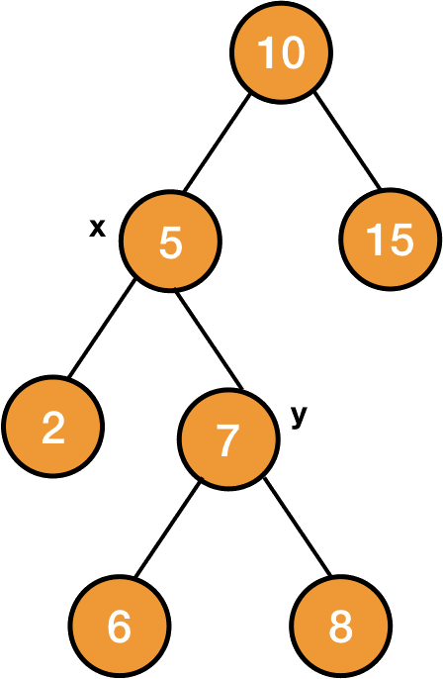
Rotations in Binary Search Tree

Slide 4

Rotations in Binary Search Tree
After applying left rotation on the node $x$, the node $y$ will become the new root of the subtree and its left child will be $x$. And the previous left child of $y$ will now become the right child of $x.$

Slide 5
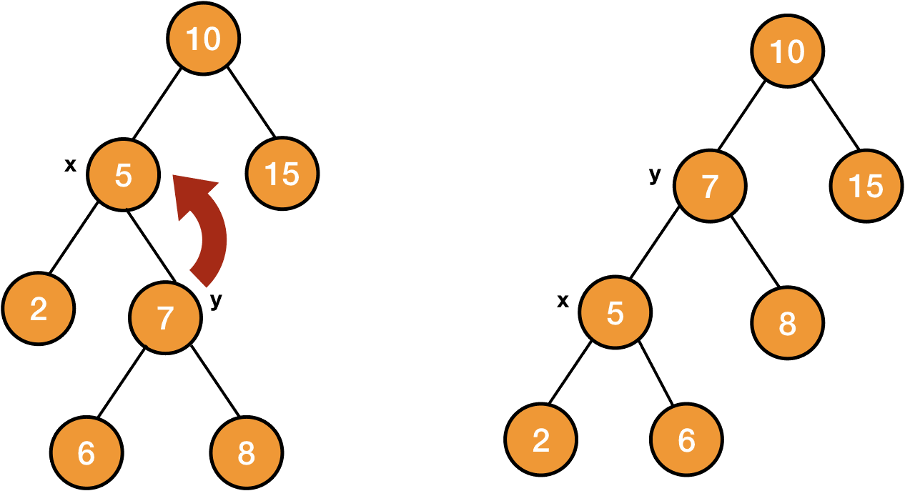
Left Rotations in Binary Search Tree

Slide 6
Left Rotations in Binary Search Tree

Slide 7
Right Rotations in Binary Search Tree
Now applying right rotation on the node y of the rotated tree, it will transform back to the original tree.

Slide 8
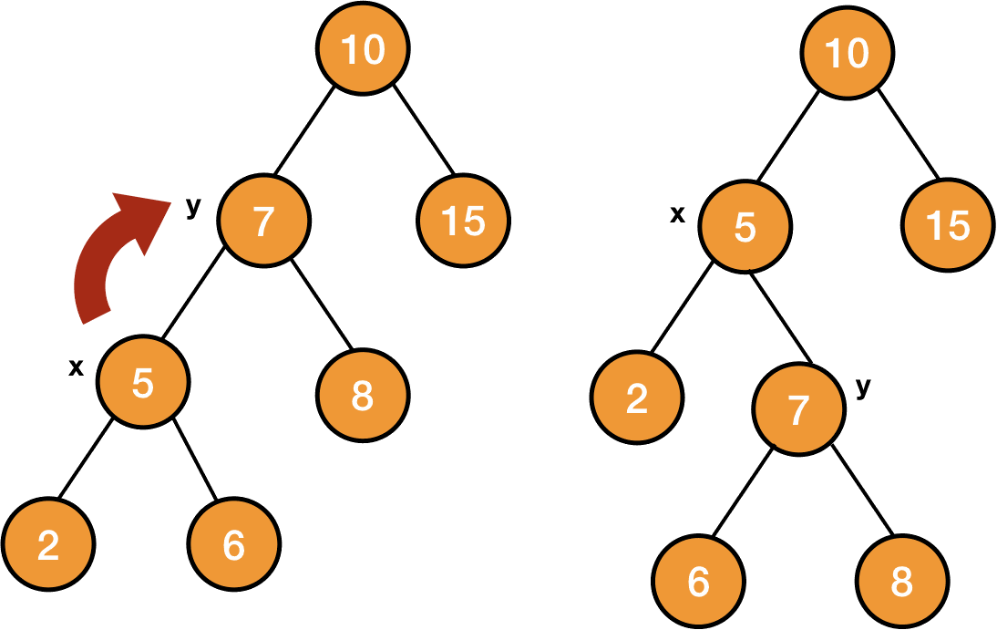
Right Rotations in Binary Search Tree
So right rotation on the node y will make x the root of the tree, y will become x's right child. And the previous right child of x will now become the left child of y.

Slide 9
Right Rotations in Binary Search Tree

Slide 10
Right Rotations in Binary Search Tree

Slide 11
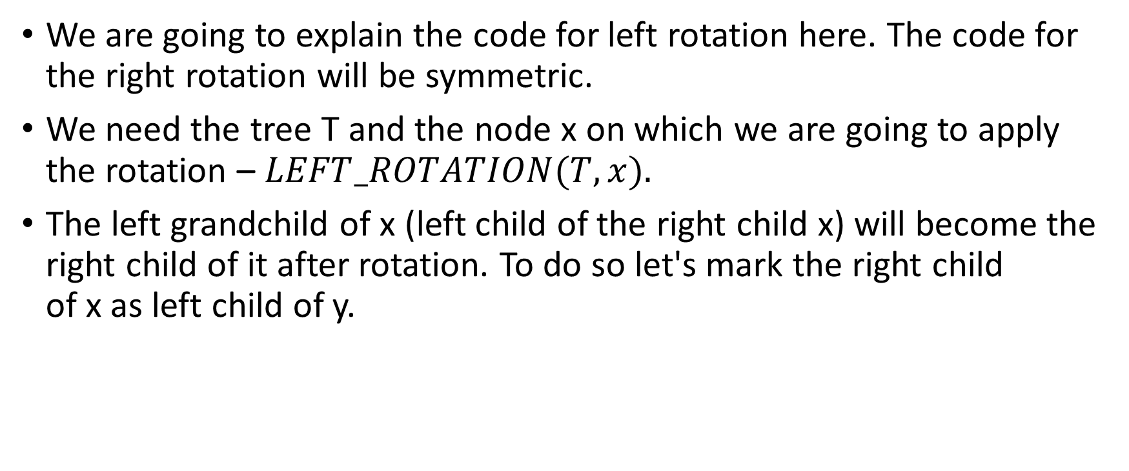
Code of Rotations
We are going to explain the code for left rotation here. The code for the right rotation will be symmetric.
We need the tree T and the node x on which we are going to apply the rotation – $LEFT_ROTATION(T, x).$
The left grandchild of x (left child of the right child x) will become the right child of it after rotation. To do so let's mark the right child of x as left child of y.

Slide 12
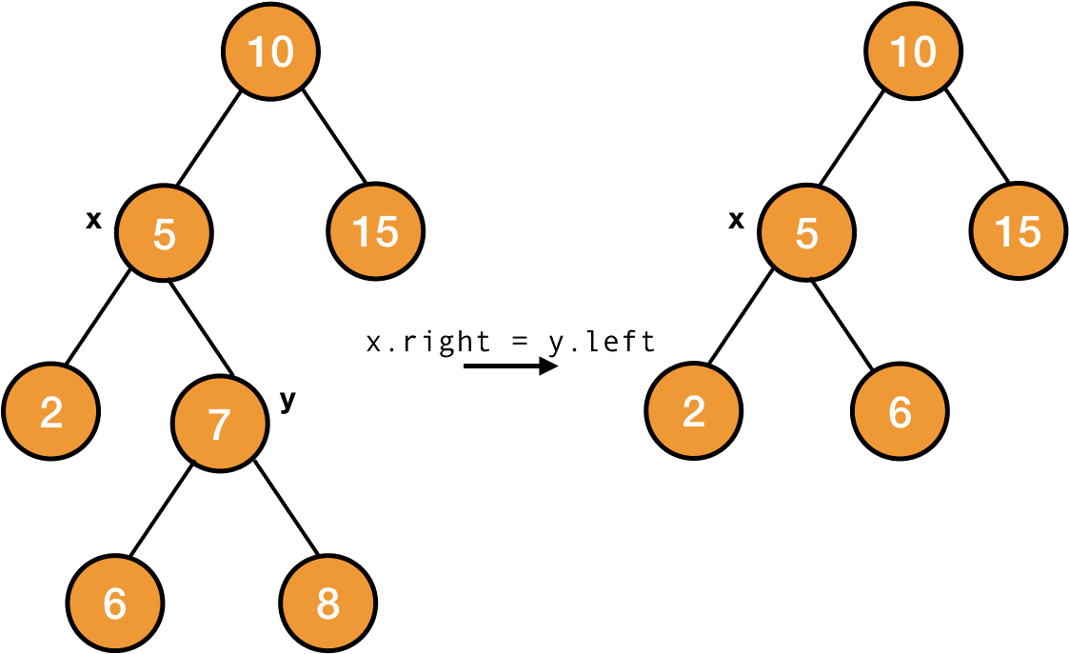
Code of Rotations

Slide 13
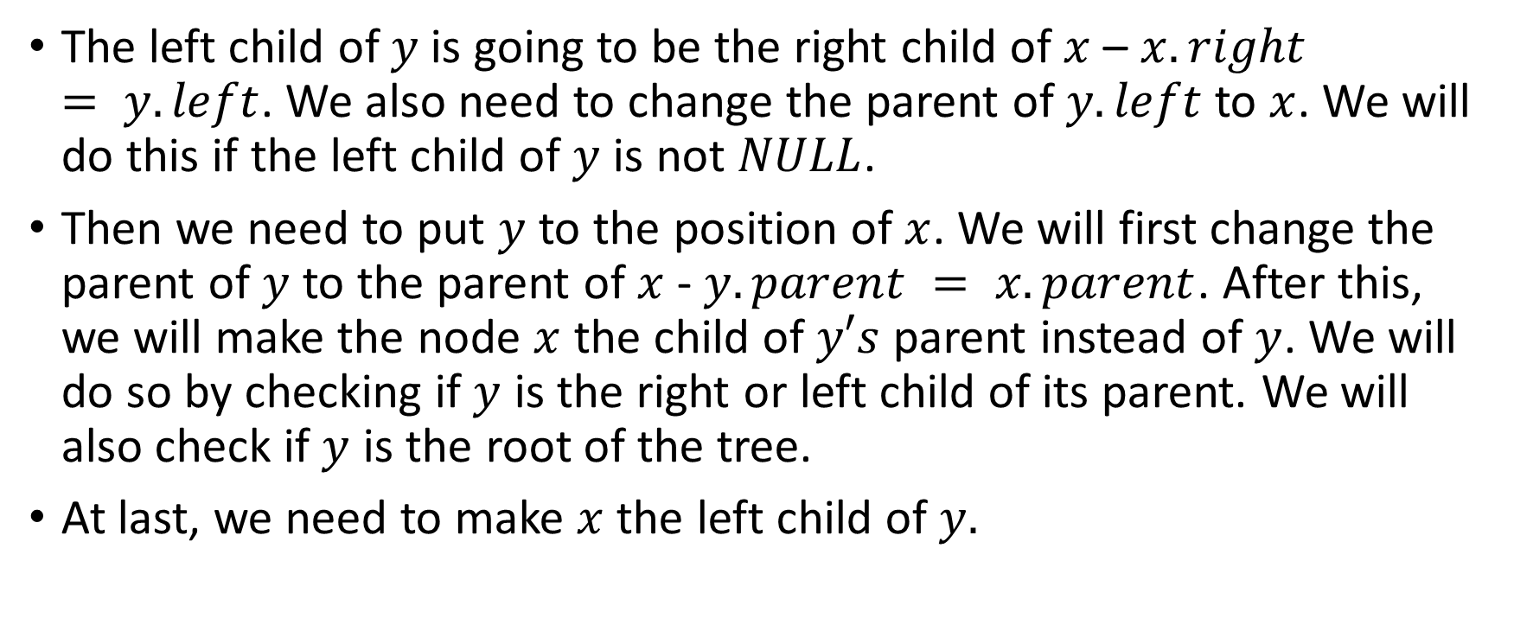
Code of Rotations
The left child of $y$is going to be the right child of $x$ – $x.right = y.left$. We also need to change the parent of $y.left$ to $x$. We will do this if the left child of $y$ is not $NULL$.
Then we need to put $y$ to the position of $x$. We will first change the parent of $y$ to the parent of $x$- $y.parent = x.parent$. After this, we will make the node $x$ the child of $y′s$ parent instead of $y$. We will do so by checking if $y$ is the right or left child of its parent. We will also check if $y$ is the root of the tree.
At last, we need to make $x$ the left child of $y.$

Slide 14
Code of Rotations

Slide 15
Algorithm of Rotations
LEFT_ROTATETION(T, x) y = x.right x.right = y.left if y.left != NULL y.left.parent = x y.parent = x.parent if x.parent == NULL //x is root T.root = y elseif x == x.parent.left // x is left child x.parent.left = y else // x is right child x.parent.right = y y.left = x x.parent = y

Slide 16

Summary of Rotations
From the above code, you can easily see that rotation is a constant time taking process $O\left(1\right).$
Now that we know how to perform rotation, we will use this to restore red-black properties when they get violated after adding or deleting any node.

